Slide 1
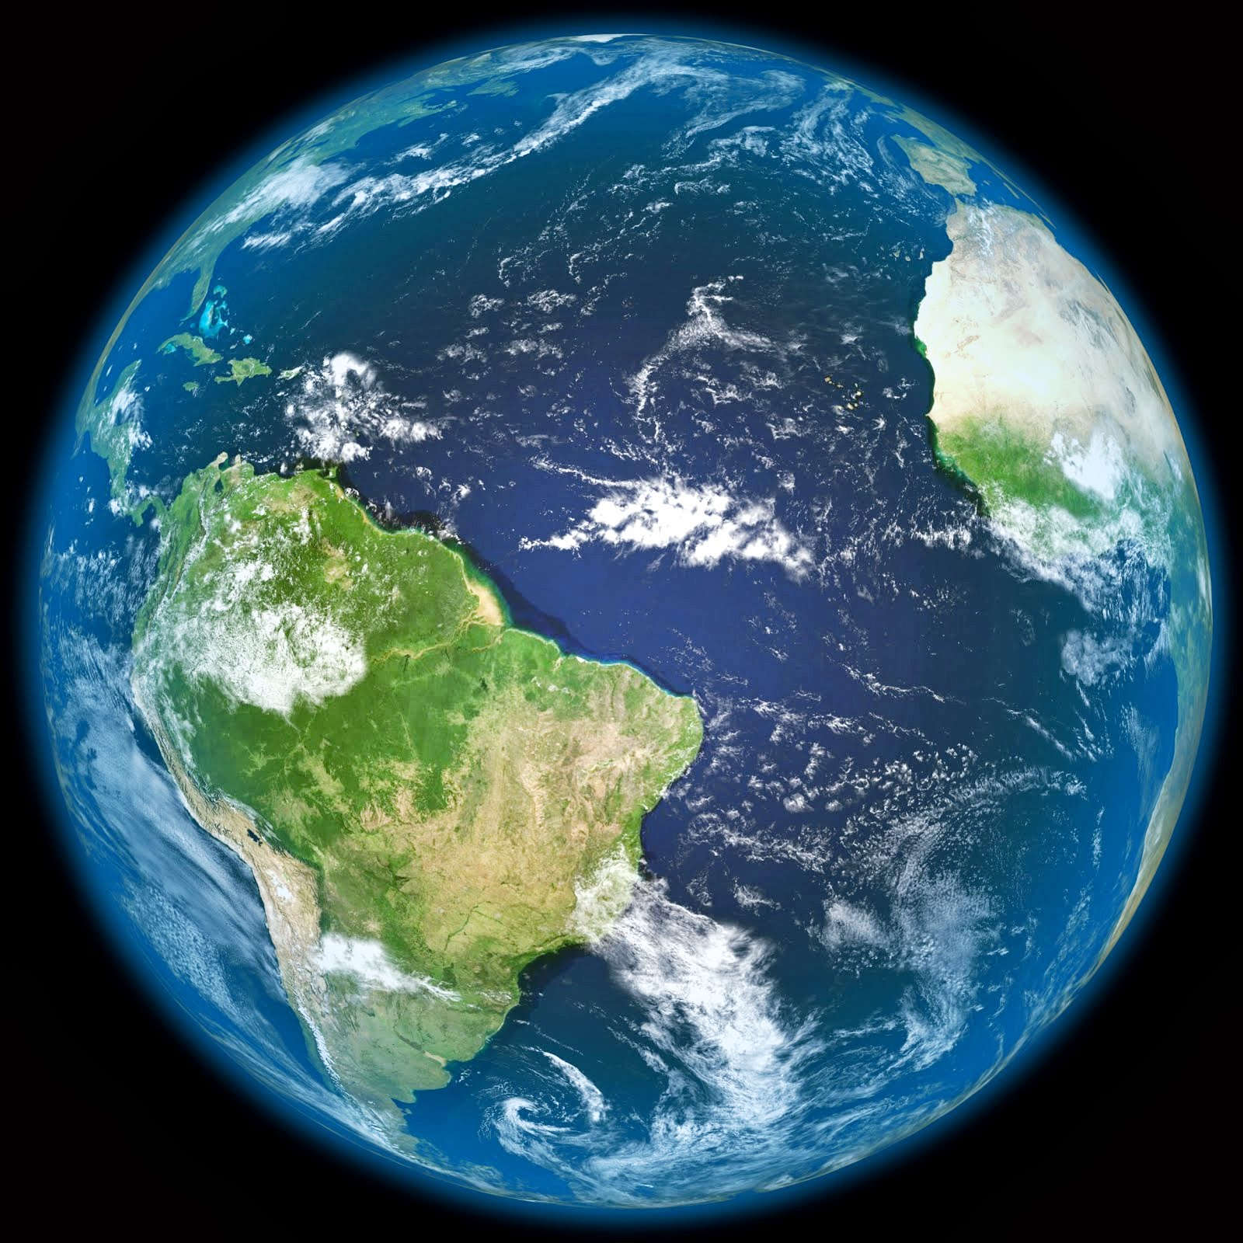
Global Warming
Notes:
1

Slide 2
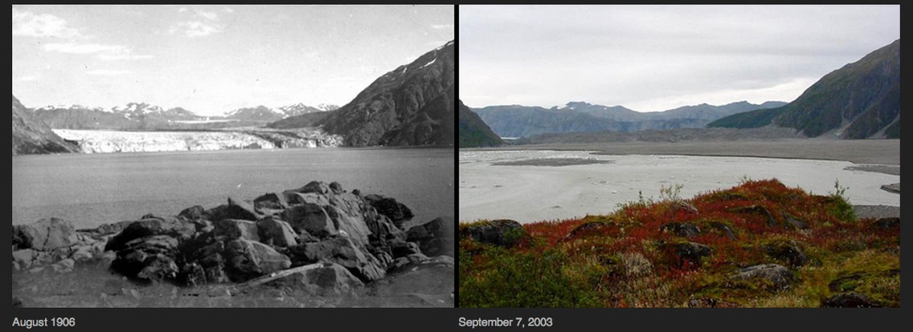
Alaska Carroll Glacier
Notes:
2

Slide 3
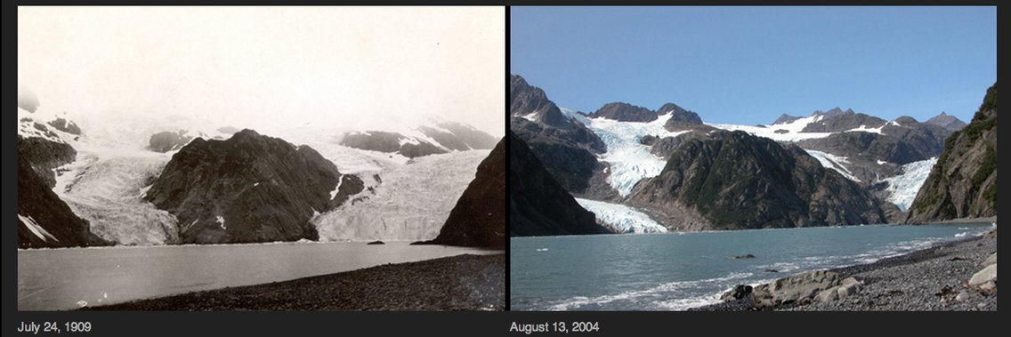
Alaska Holgate Glacier
Since 1980, the average thickness of a set of well-studied reference glaciers has decreased by an amount equivalent to more than 57 feet (17 meters) of water
Notes:
3

Slide 4
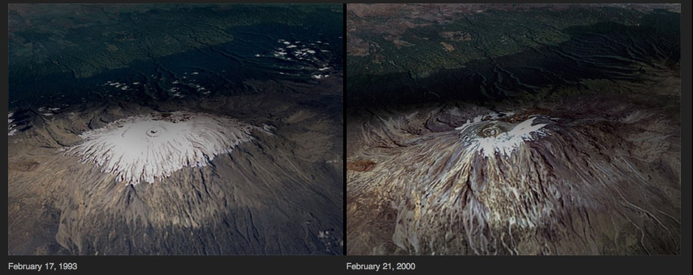
Mt Kilimanjaro
Notes:
4

Slide 5
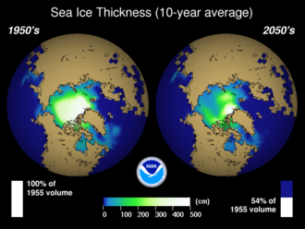
Notes:
5

Slide 6
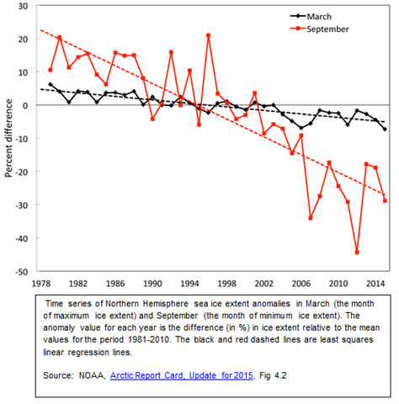
Change in Arctic Sea Ice
Notes:
6

Slide 7
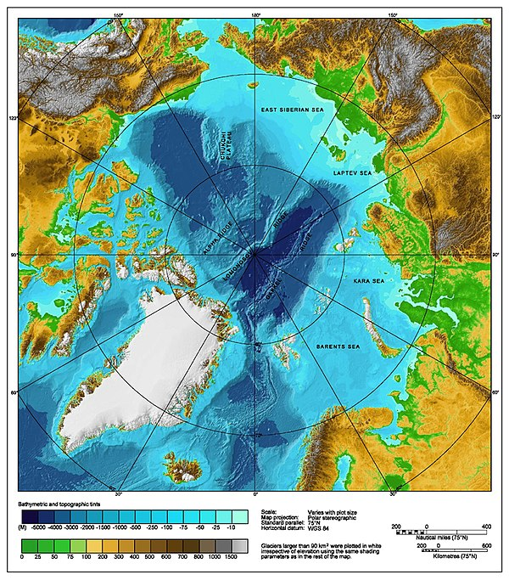
Notes:
7

Slide 8
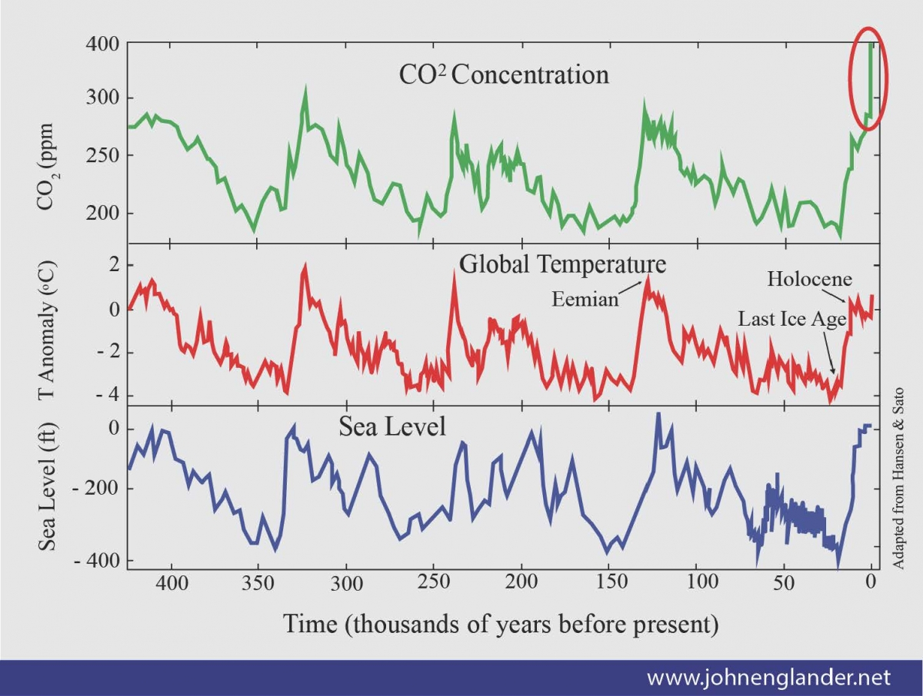
Chart of CO2, Temp, Sea Level
Notes:
8

Slide 9
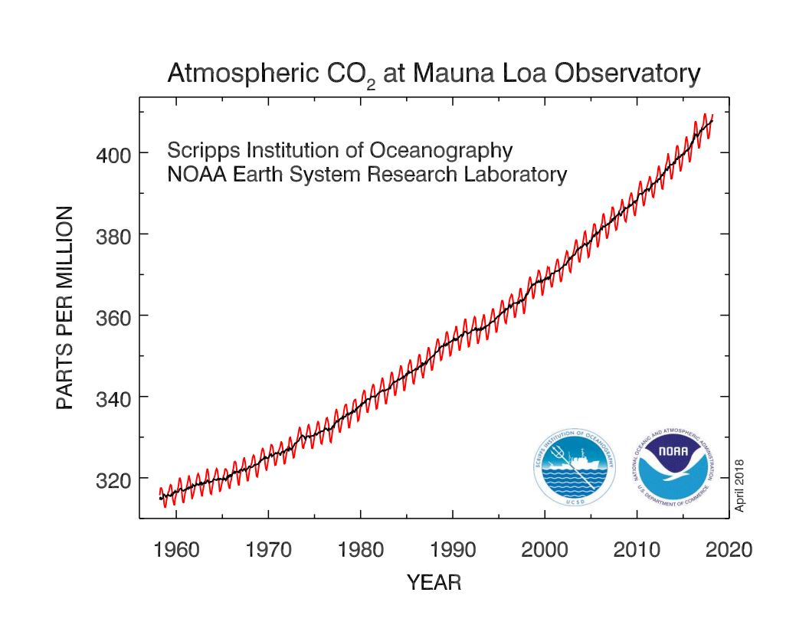
Notes:
9

Slide 10
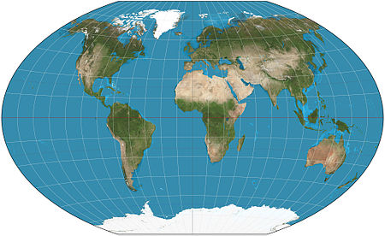
Notes:
10

Slide 11
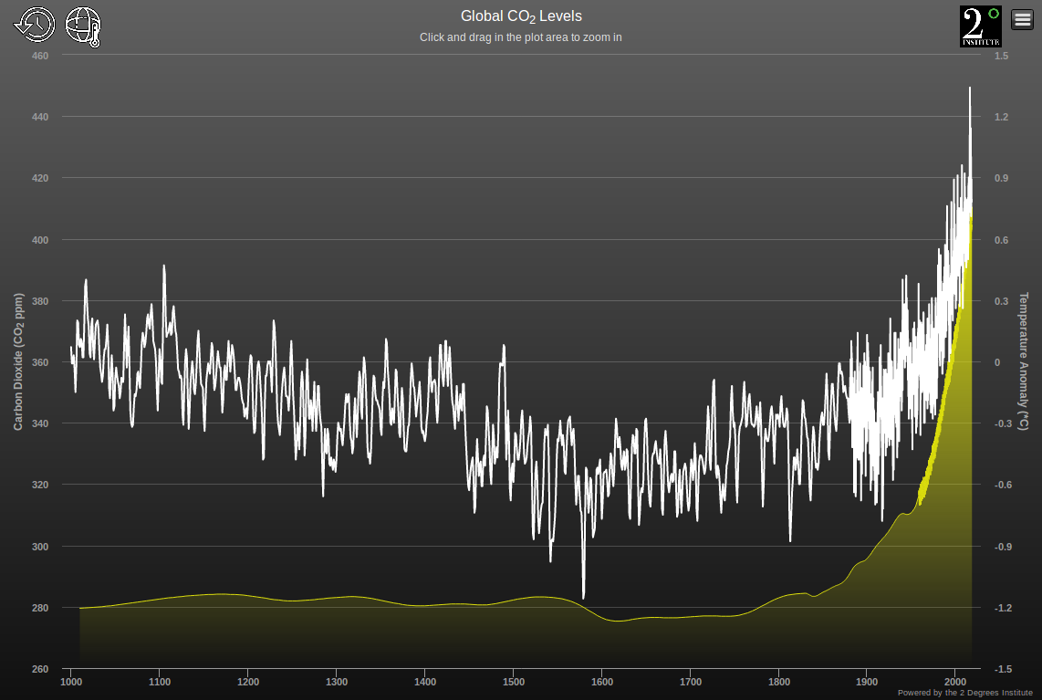
Global CO2 Levels & Temp
Notes:
11

Slide 12
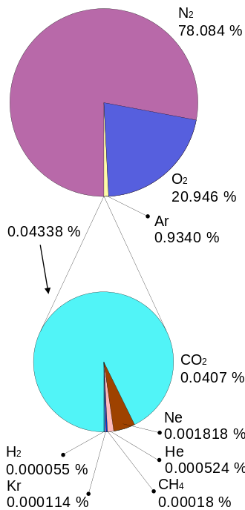
Composition of Earth’s Atmosphere
Notes:
12

Slide 13
The Main GHGs
Gas | Lifetime (Yrs) | Proportion vs CO2 | Global Warming Potential vs CO2 over 20 Yrs | Comments
Carbon Dioxide (CO2) | 30-95 | 1 | 1 | Fossil Fuels Agriculture
Methane (CH4) | 12 | 1/220 | 84x | Oil & gas Agriculture Waste Mgmt
Nitrous Oxide (NO2) | 121 | 1/1350 | 264x | Fertilizer use Fossil fuels
-also water vapour, CFCs, HFCs
Notes:
13

Slide 14
Sources of GHGs
Source | Proportion | Comments
Power Plants | 25 – 30% | Coal, oil, natural gas
Buildings | 18% | heating/cooling
Industry | 15% | Includes cement & petrochemicals
Transport | 12% | road/aviation
Energy Industry | 13% | Includes oil & gas production/coal mining
Land use | 15% | includes deforestation, degradation, land use change/soil use
Livestock | 6% | Carbon dioxide, methane
Waste | 3% | solid & water
https://allianz.com/en/about_us/open-knowledge/topics/environment/articles/140912-fifteen-sources-of-greenhouse-gases.html/#!m4432cf0e-cb70-4ff1-bc0e-5e5c2797e856
Notes:
14

Slide 15
Scope of the Climate Change Problem
Rolling Stone Magazine – July 19, 2012
2 degrees Celsius
565 Gigatons
2795 Gigatons
Notes:
15

Slide 16
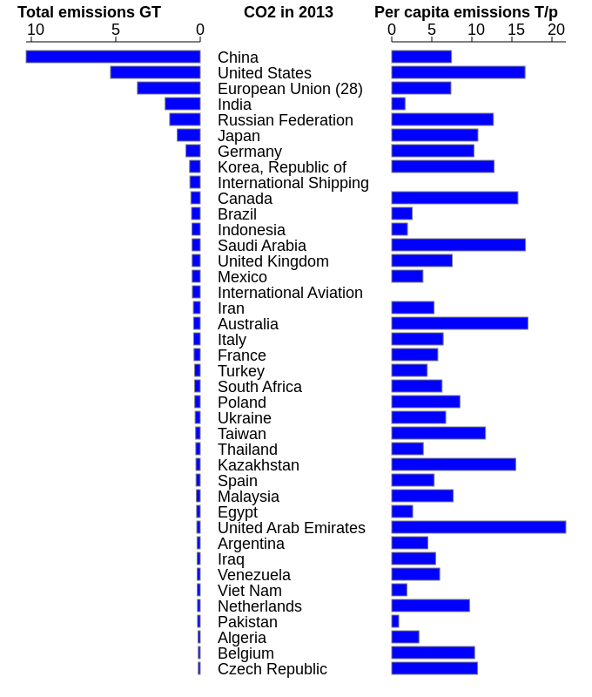
Notes:
16

Slide 17
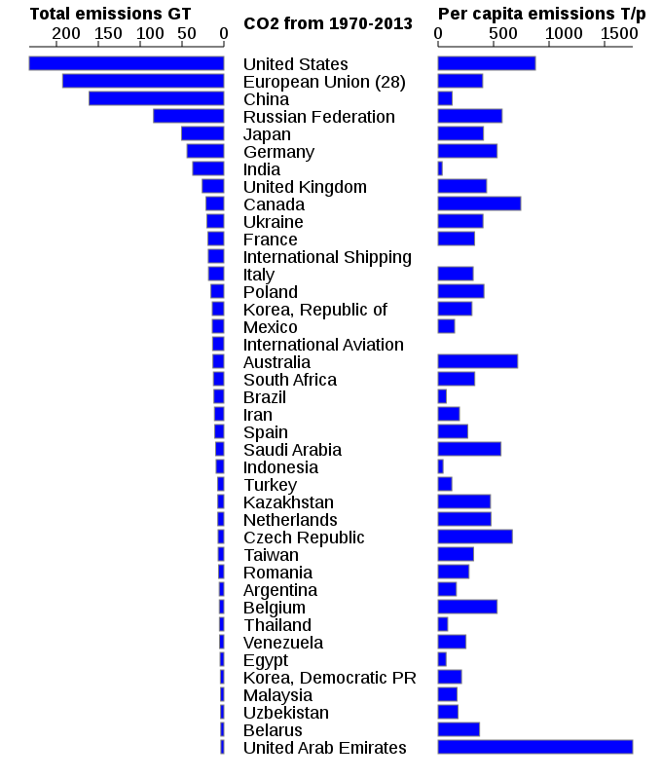
Notes:
17

Slide 18
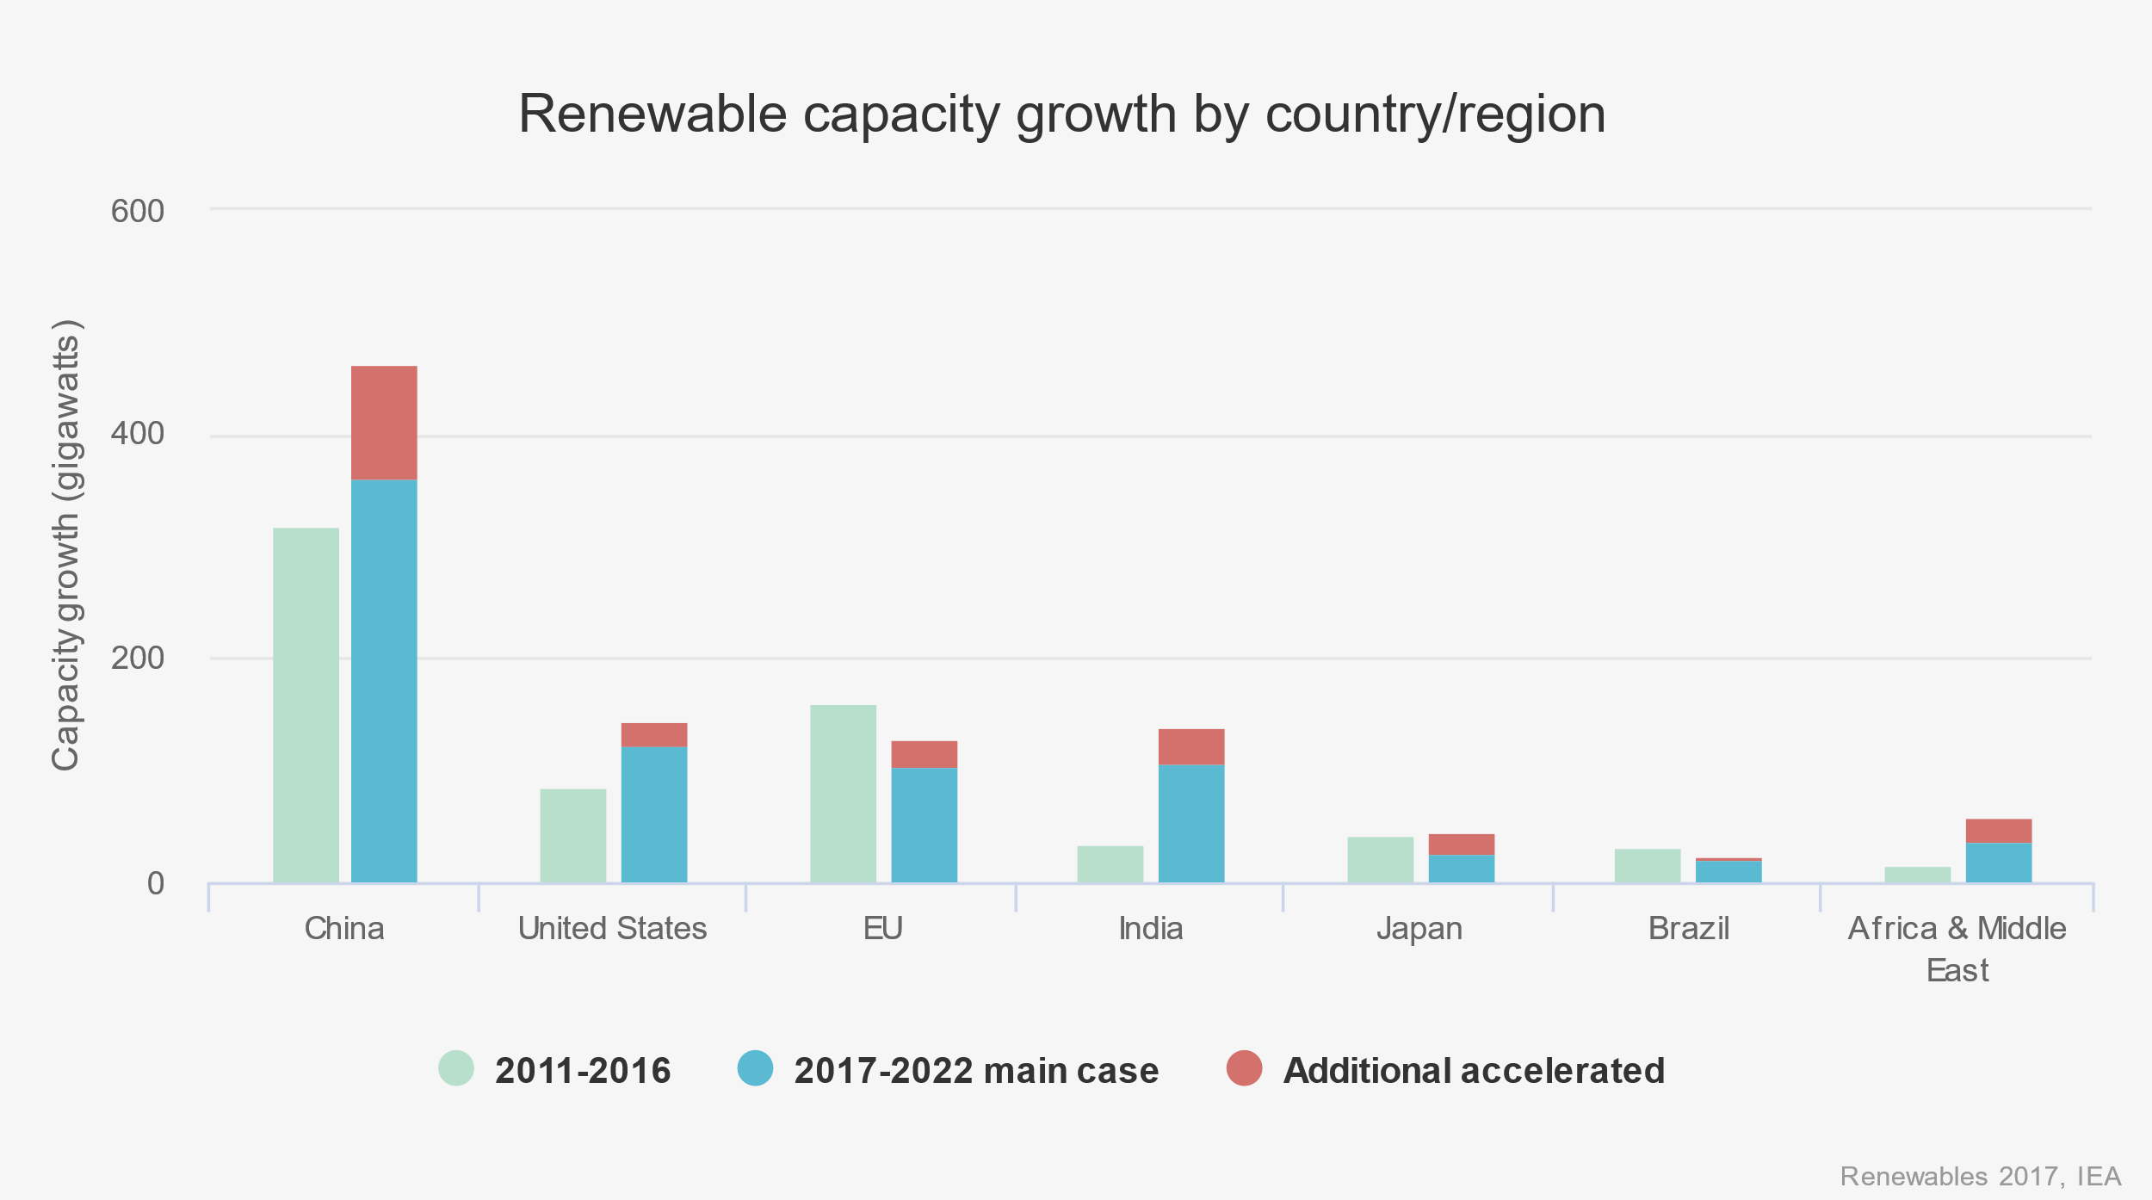
Renewable Energy Capacity Growth
Notes:
18

Slide 19
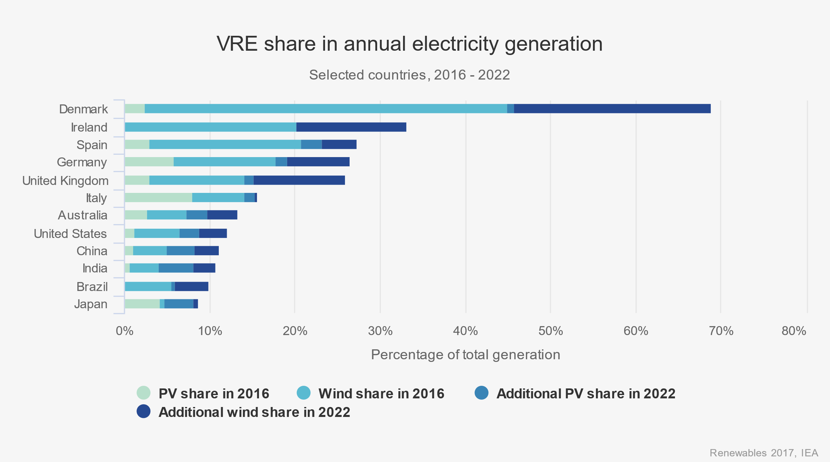
Renewable Energy’s Share of theTotal
Notes:
19

Slide 20
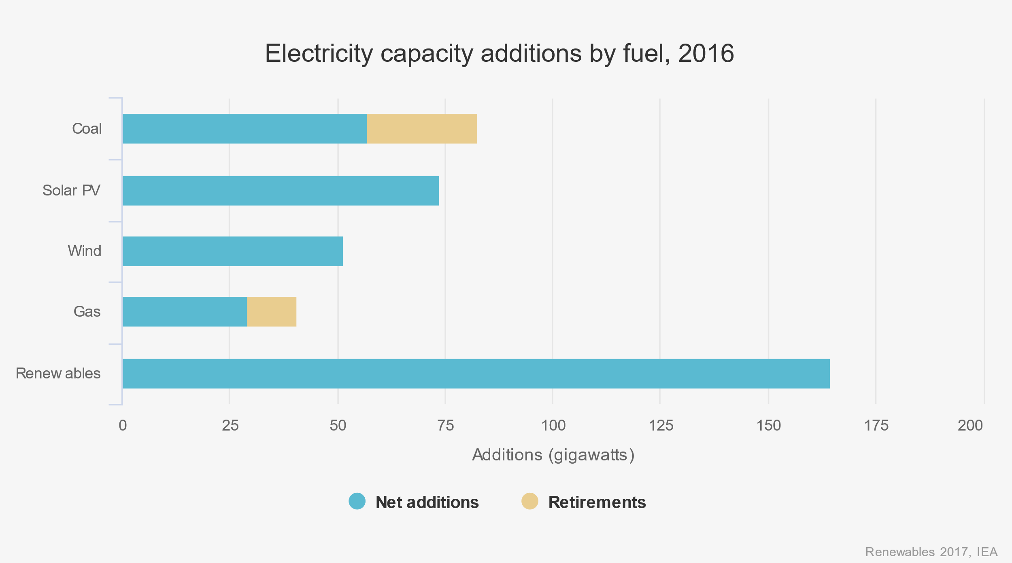
Changes in Fuels Used for Electric Power Generation
Notes:
20

Slide 21
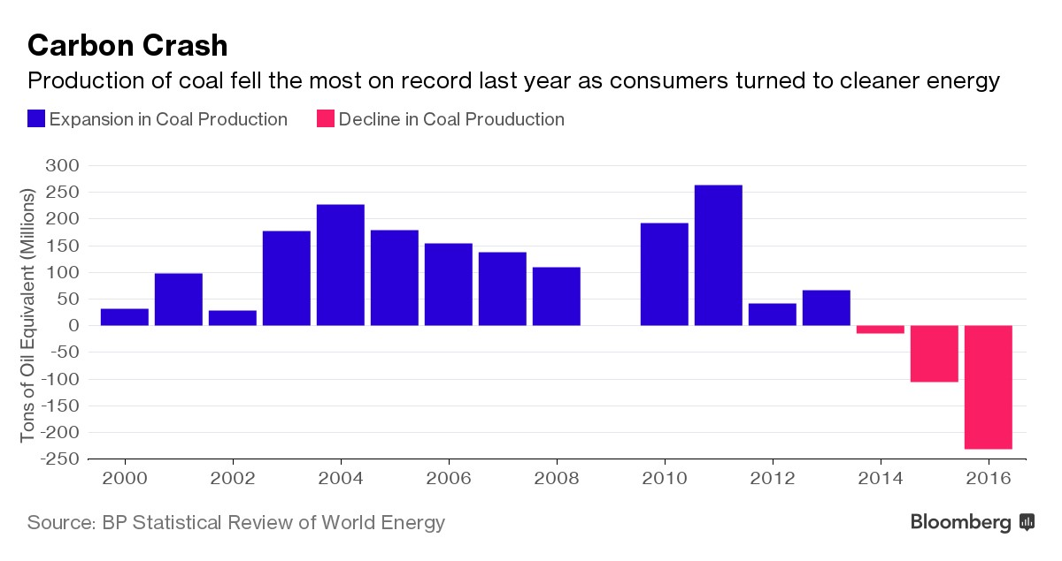
Notes:
21

Slide 22
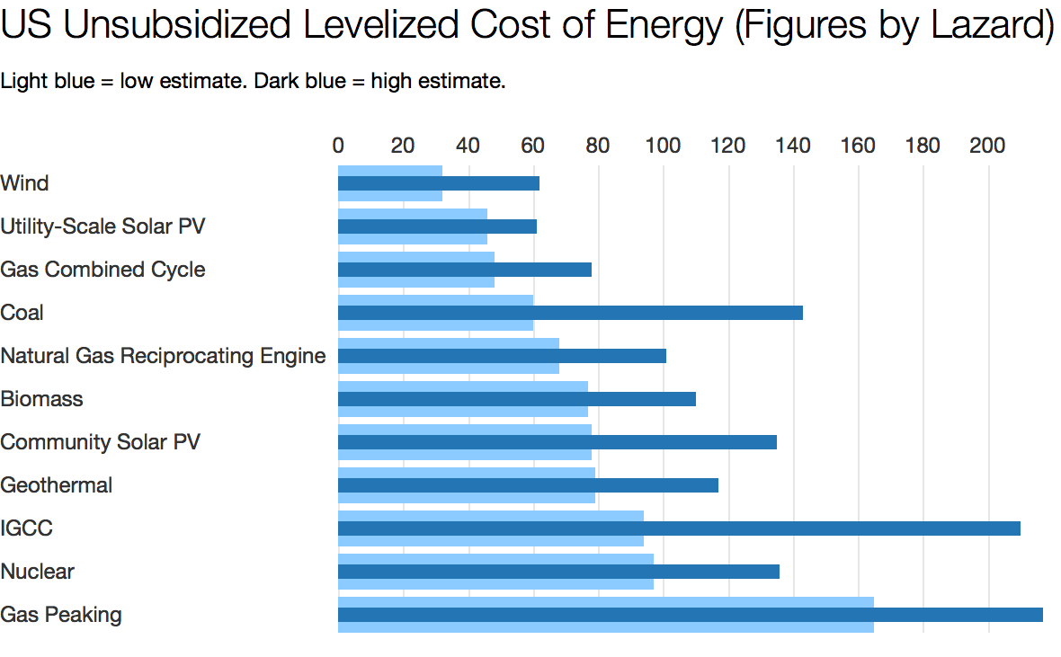
$/Mwh
Notes:
22

Slide 23
What Can We Do?
Governments:
Federal
International Cooperation – COP commitments
Incentives/subsidies/taxes – carbon pricing
Funding for domestic research
Funding to developing nations
Provincial
Incentives/subsidies/taxes – cap and trade
Green Ontario Fund
Individual
Education
Respond to economic incentives
Lifestyle choices
Notes:
23

Slide 24
Drawdown Summary of Possible Reduction of GHGs by Sector over Next 30 Years
Sector | PossibleTotal Atmospheric CO2-EQ Reduction(GT) | Net Cost ($USbillions) | Net Savings ($USbillions)
Buildings & Cities | 55 | 4,778 | 17,906
Energy | 246 | 4,923 | 20,959
Food | 322 | 777 | 10,017
Land Use | 150 | 65 | 1,250
Materials | 112 | 1,125 | 1,040
Transport | 46 | 15,676 | 22,666
Women & Girls | 121 | N/A | 88
Notes:
24

Slide 25
Drawdown Challenge April 4-25
Drawdown Solutions
Buildings & Cities
Energy
Food
Land Use
Materials
Transport
Women & Girls
Notes:
25

Slide 26
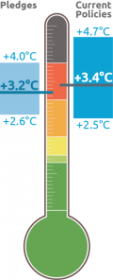
How Are We Doing?
Notes:
26

Slide 27
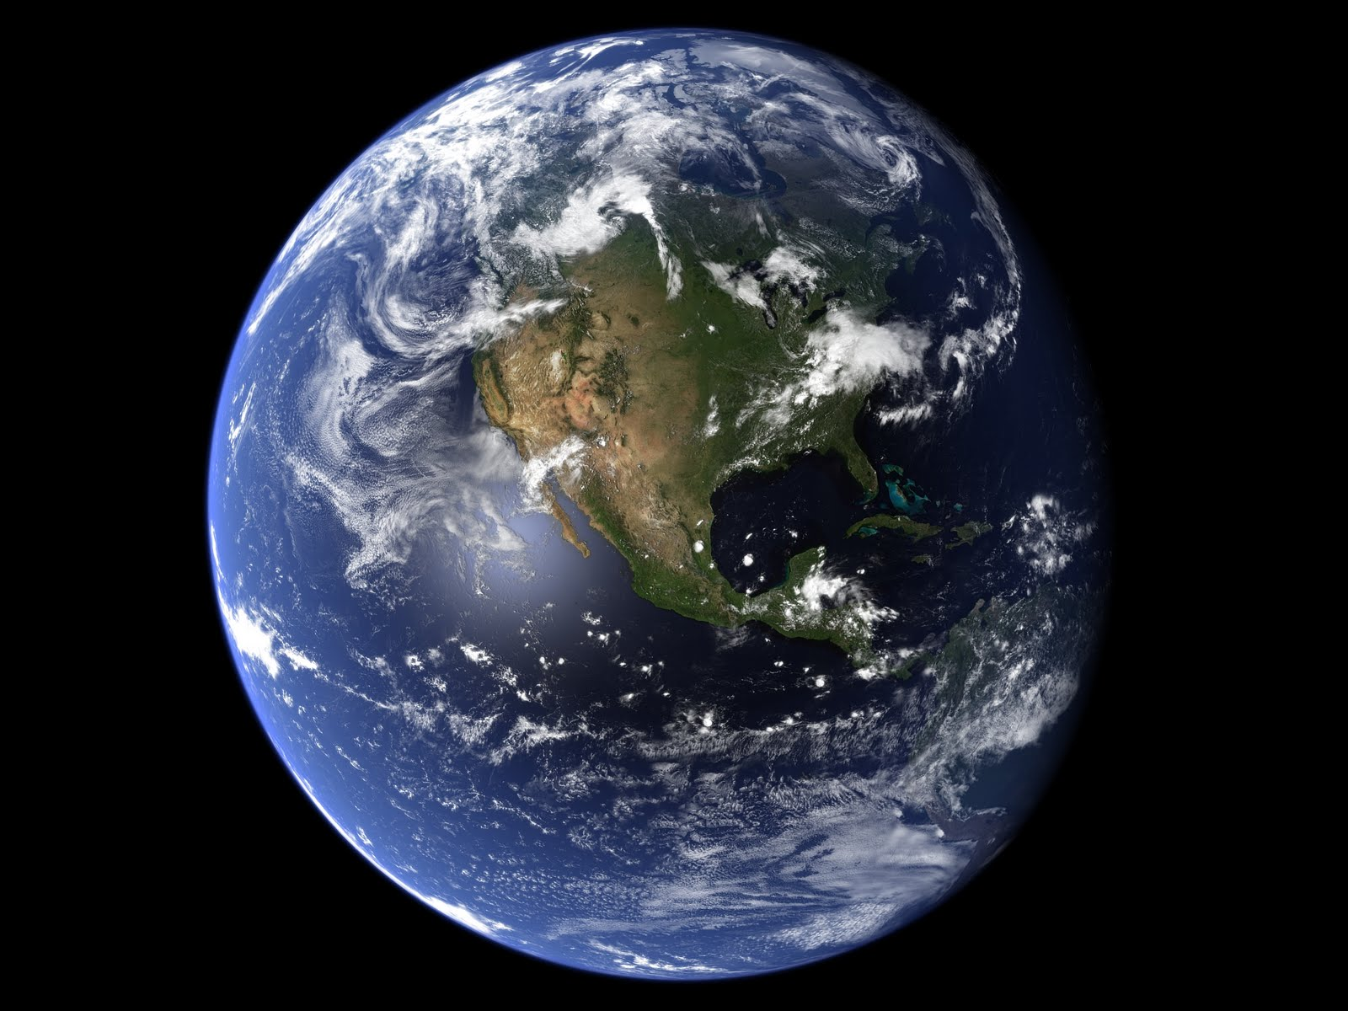
Notes:
27

Slide 28
Rank | Solution | Sector | Total CO2 equivalent Reduction (Gt) | Net Cost ($USbillions) | Net Savings ($USbillions)
1 | Refrigeration M’gment | Materials | 89.74 | N/A | -902.77
2 | Onshore Wind Turbines | Energy
Notes:
28

Slide 29
Ontario’s Energy Mix (Apr 20/2018)
Source | Percent of Total | Generation (MW)
Nuclear | 58.3 | 9215
Hydro | 24.6 | 3893
Nat Gas | 11.2 | 1777
Wind | 5.2 | 780
Solar | <1 | 125
Biofuel | <<1 | 27
Notes:
29

Slide 30
Ontario Hydro Rates
TOU Pricing (cents per kWh)
Peak – 13.2c
Midpeak – 9.5c
Offpeak – 6.5c
Current temporary reduction to cost $44b
Since Green Energy Act and before temporary reduction Ontario hydro rates increased 71% over last 10 years (Can avg 34%)
RE supplies 7%, cost is 30% of increase
Notes:
30

Slide 31
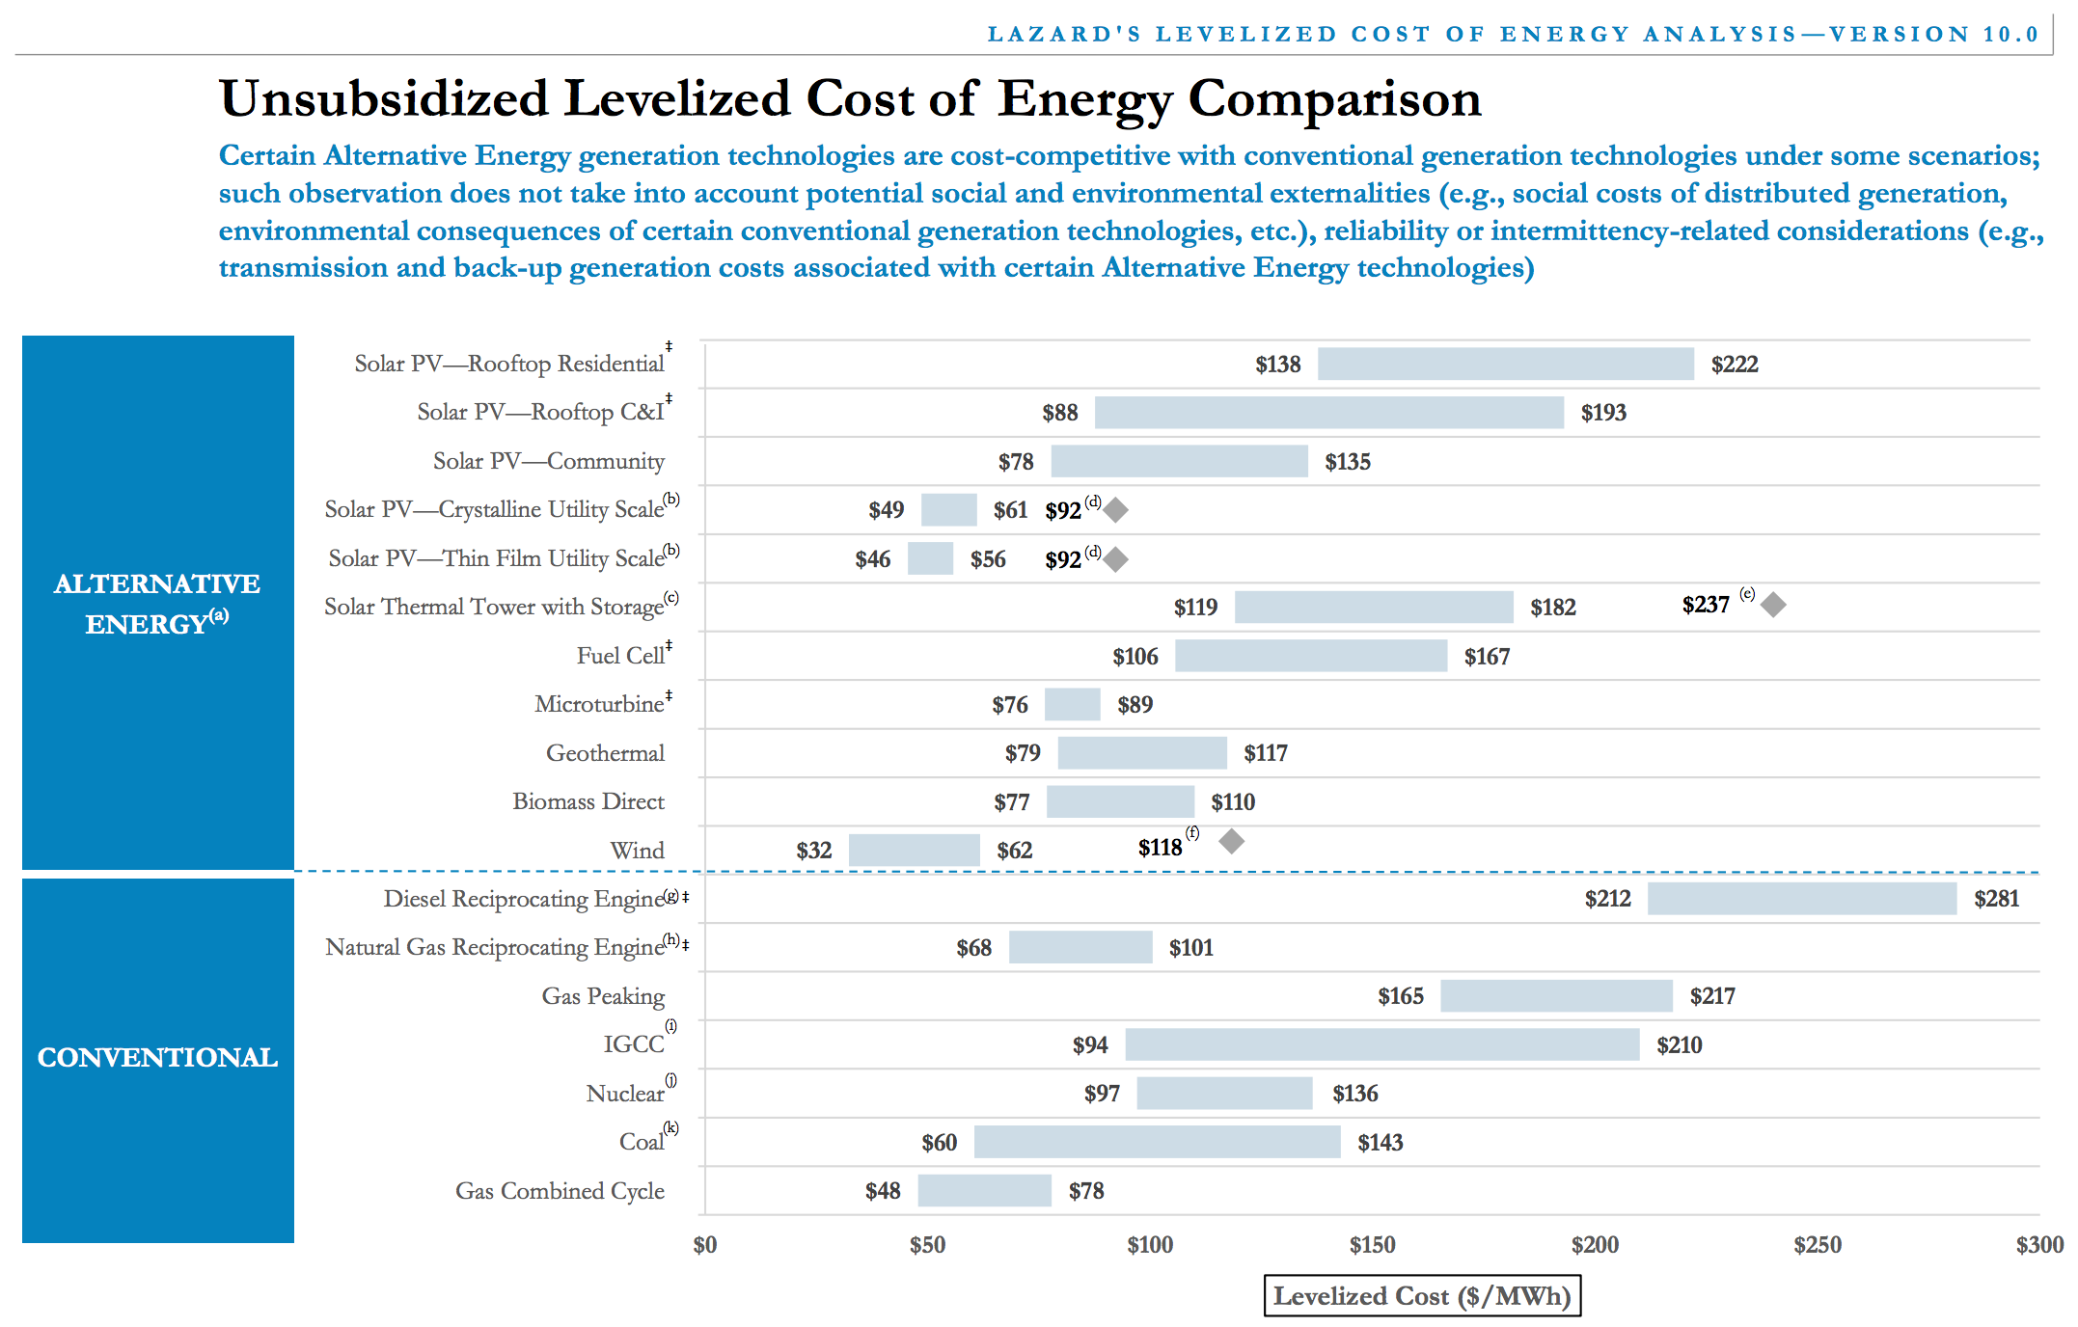
Notes:
31

Slide 32
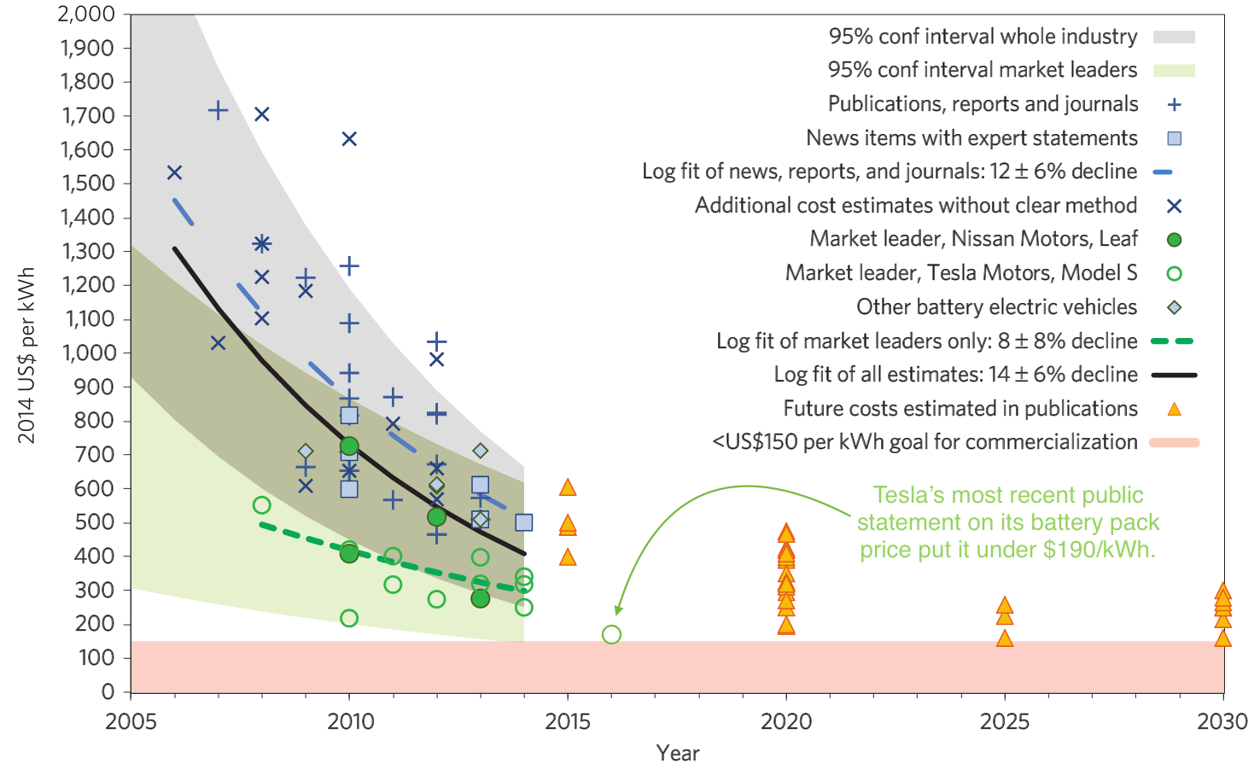
Notes:
32

Slide 33
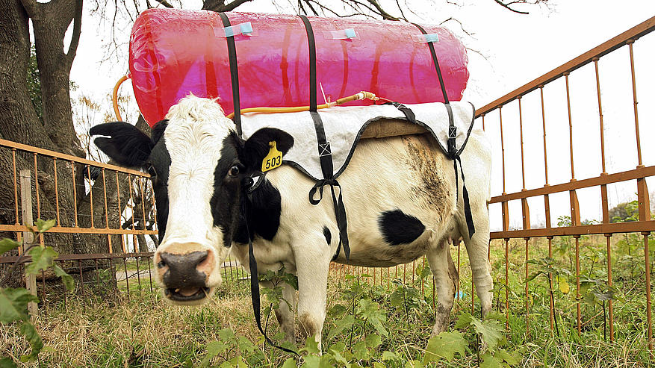
Sources of GHGs
Livestock
Greenhouse Gas: Methane
A cow in Argentina has its methane belches collected in a plastic tank. Argentine scientists say cows could be generating 30% of Argentina’s emissions. Almost half of all global methane emissions come from belching livestock and their manure, making livestock farming a significant contributor to climate change.
Methane is twenty times more potent as a greenhouse gas than CO2 although it does not last as long in the atmosphere, eventually breaking down into carbon dioxide and other gases.
Notes:
33

